Slide 1
Sky bank

Slide 2

Home page

Slide 3
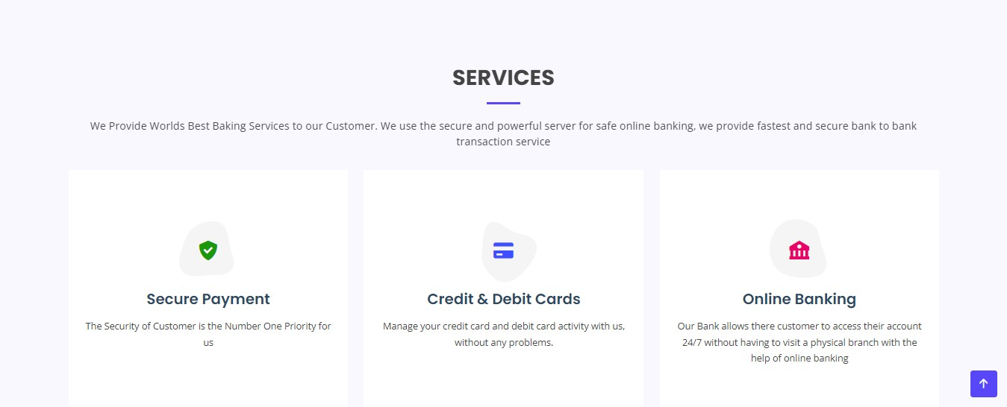
Services

Slide 4
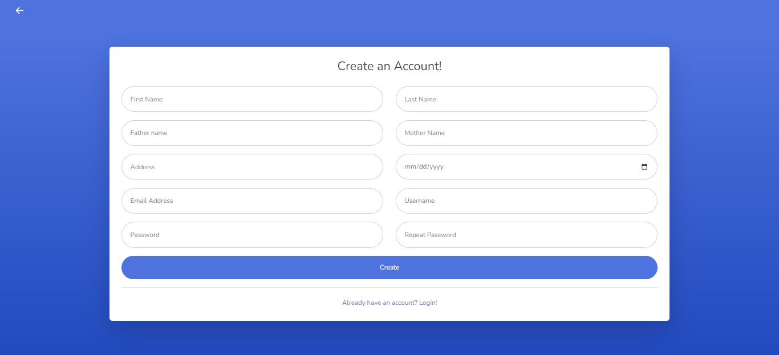
Sign up page

Slide 5
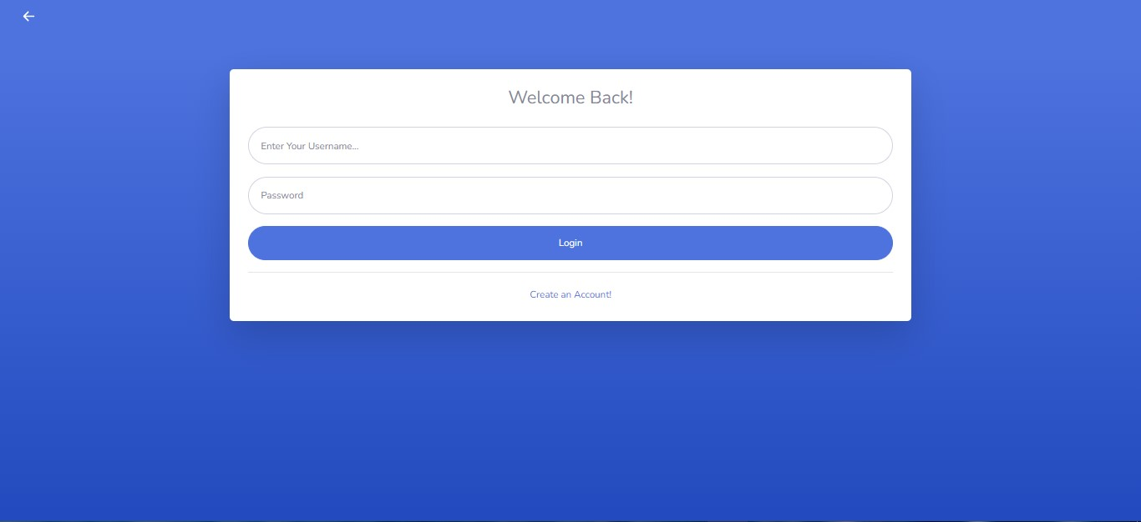
Login page

Slide 6
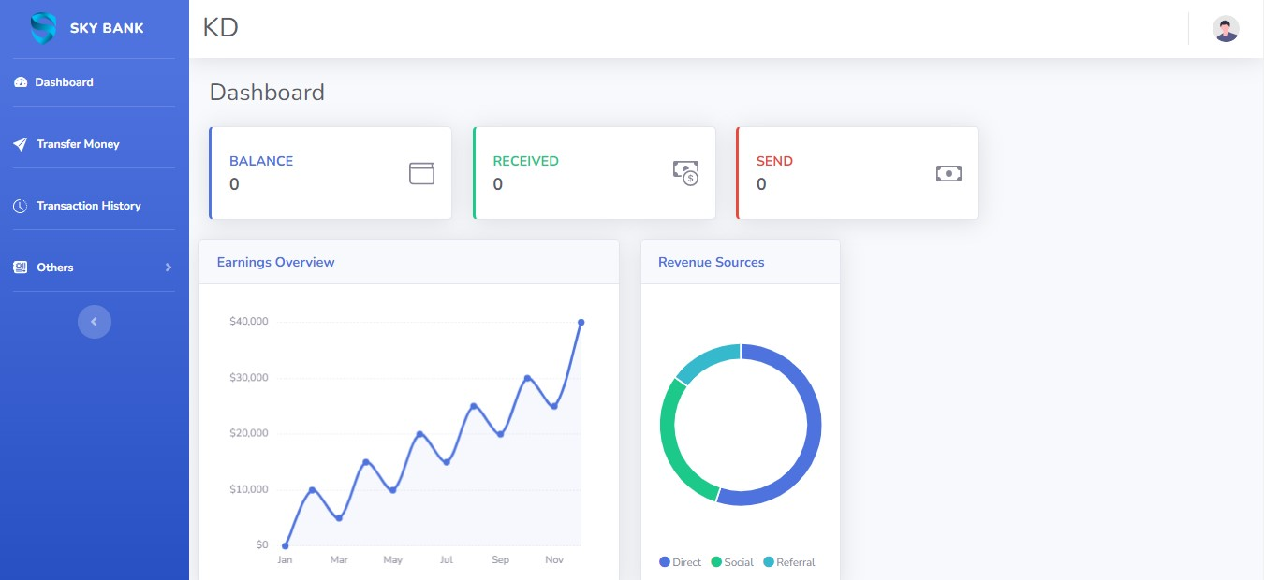
Dashboard page

Slide 7
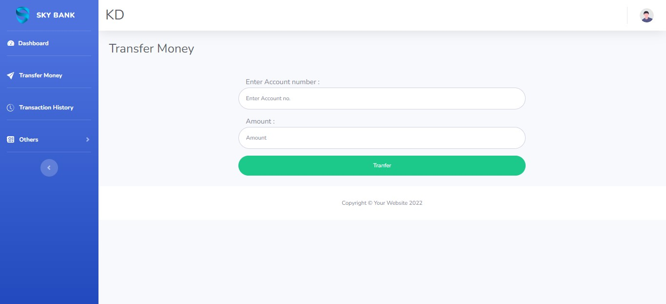
Transfer money

Slide 8
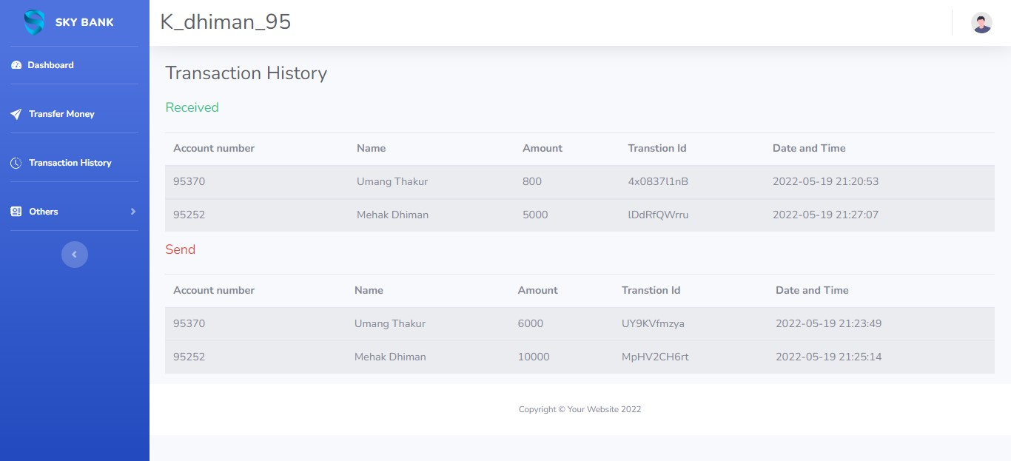
Transaction history

Slide 9
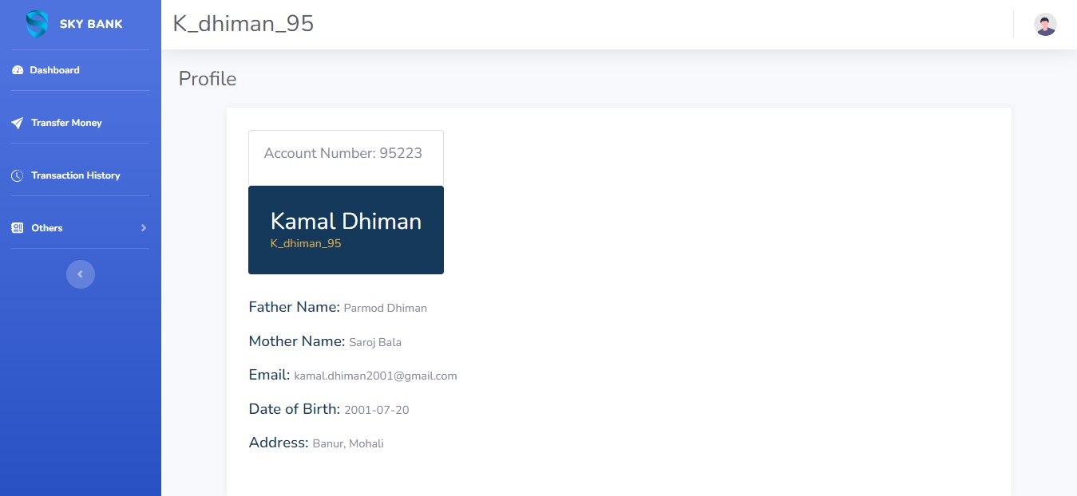
Profile page

Slide 10
Thank you

